Slide 1
Advanced CSS
Module 02

Slide 2
Why do we use CSS?

Slide 3
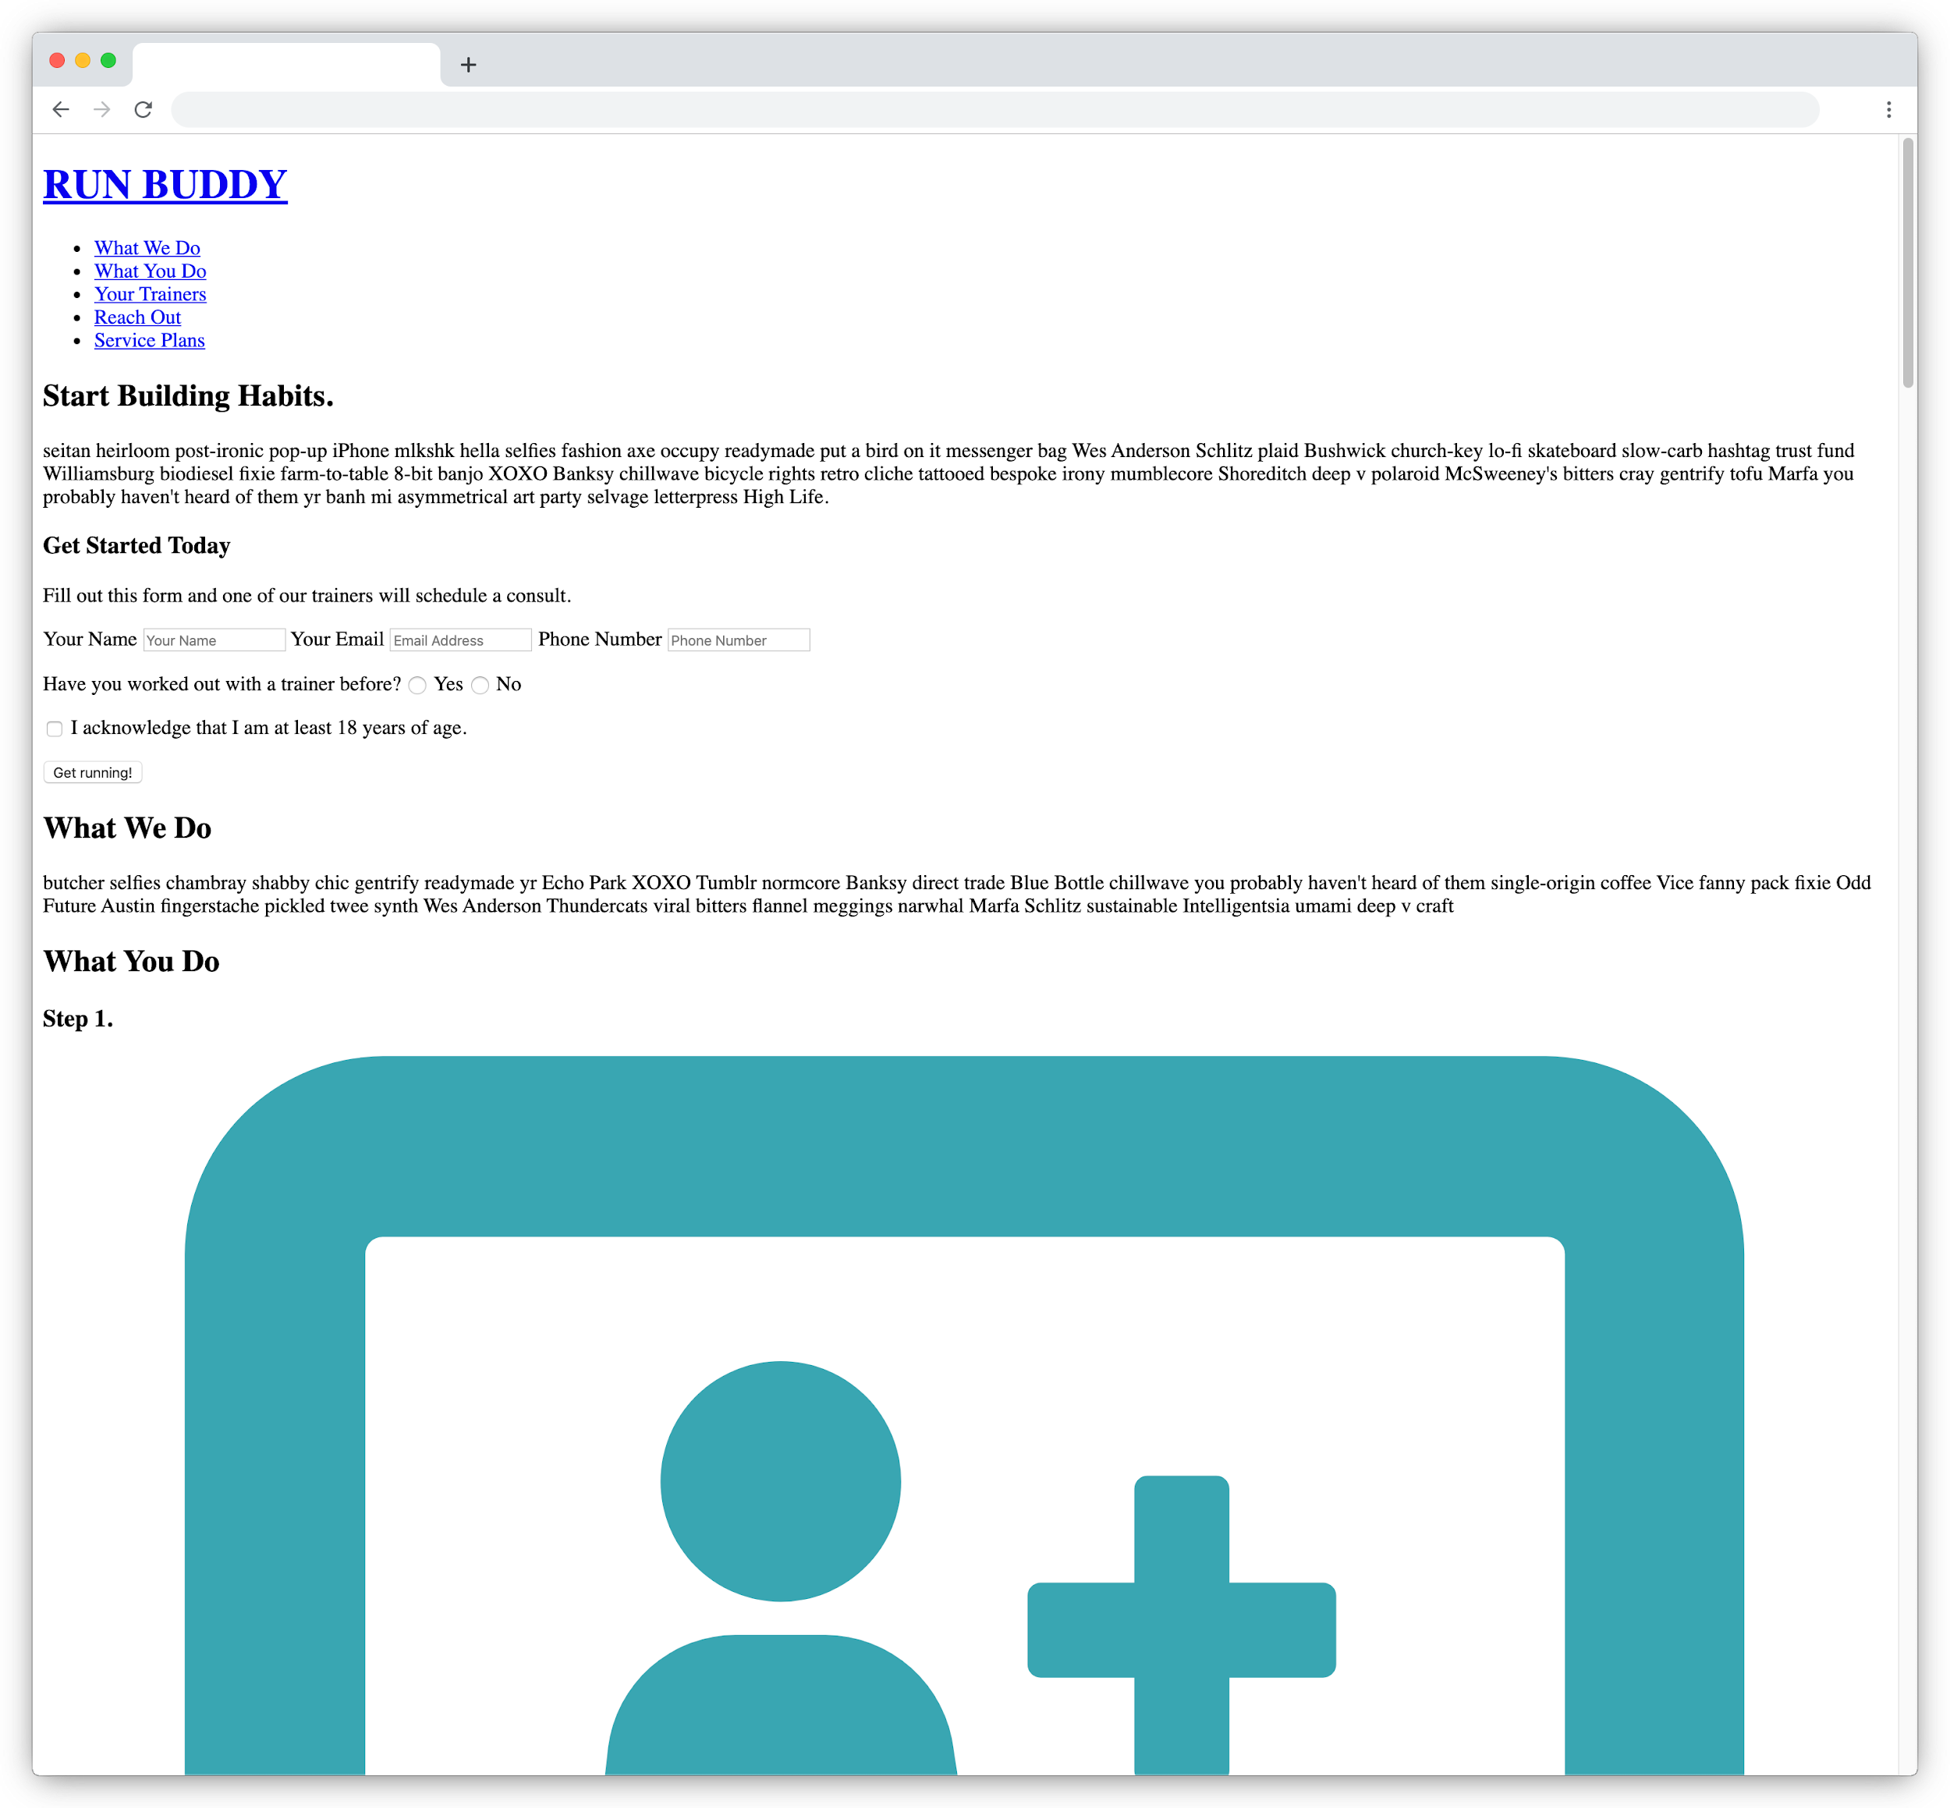
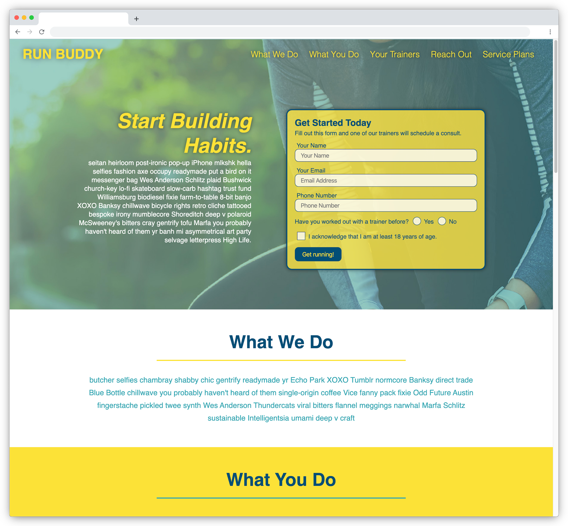
Why We Use CSS
CSS allows us to make plain HTML content look clean and presentable to users.

Slide 4
What are some features of a well-designed app?

Slide 5


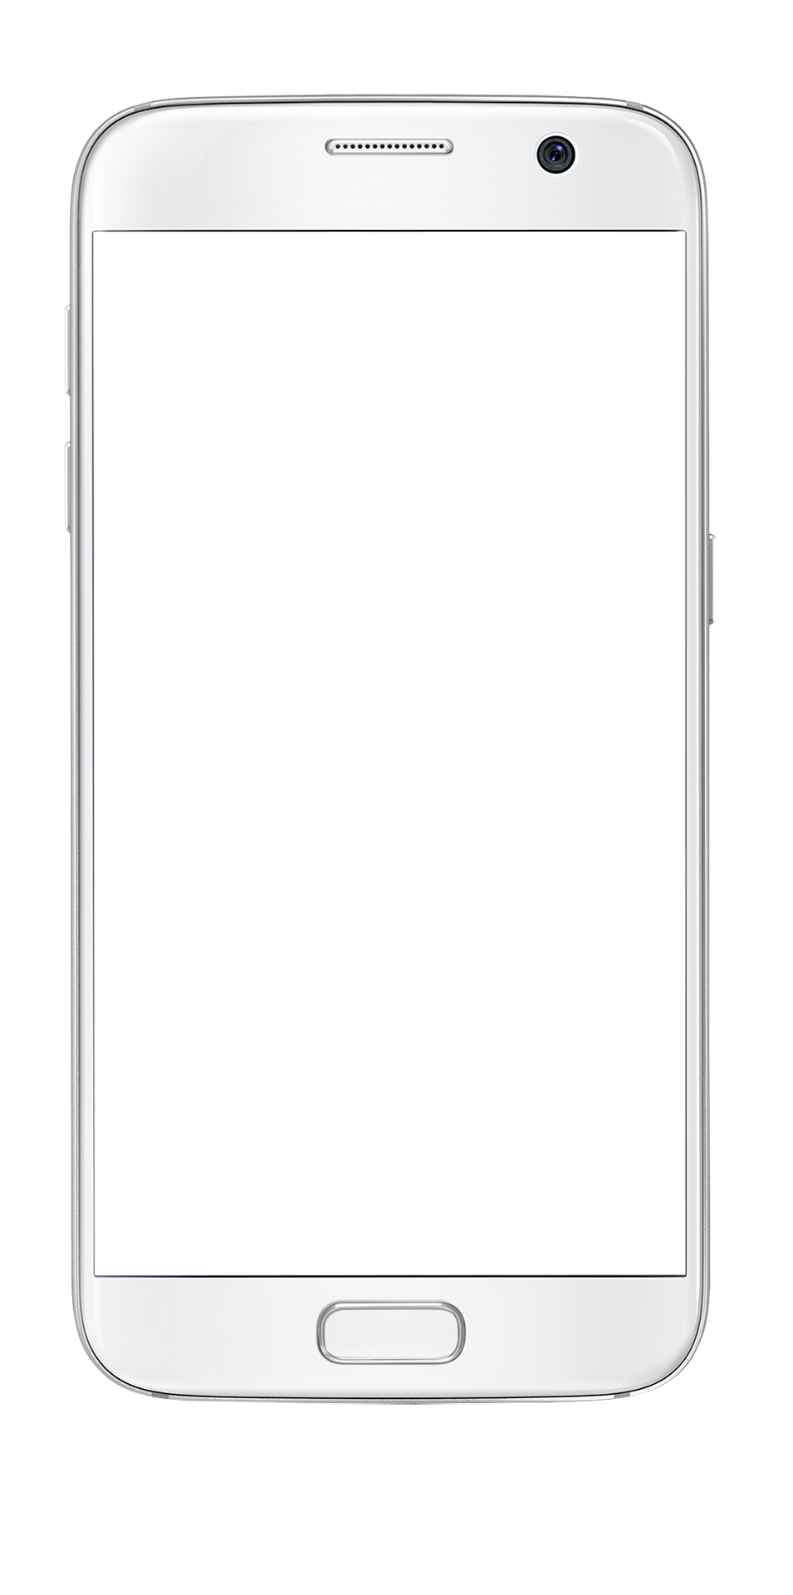

Features of Well-Designed Apps
Mobile-responsive layout
Elevate360
Good use of color contrast and space
search music
Country
Metal
Readable font sizes
Pop Rock
Hip-hop
Accessible design
Podcast
Indie Rock
Features that enhance the user’s experience
Advanced Settings

Slide 6
What is our role in implementing these features?

Slide 7
Our Role in App Design
We are not graphic designers, but as web developers, it is our job to build a user interface that is usable and visually appealing to the app’s target audience. It is also our job to make sure the application does the following:
01
Follows accessibility standards
02
Performs well on both mobile and desktop devices
03
Is easy to maintain

Slide 8
Can we build well-designed apps with CSS?

Slide 9
Yes, We Can!
Browsers are constantly adding support for more CSS-based tools that we can use, including the following:
Flexbox and grid for responsive layouts
Transitions for animating the user interface
New units of size for developers to use
Image color filtering
And more!

Slide 10
How can we learn to build these features?

Slide 11
How to Learn CSS
CSS is a unique language, as it gives the developer many options for how to accomplish a goal.
HTML (Structure)
CSS (Presentation)
<p>
Hello, World!
<em>
text
Hello, World!
Hello,
World!
Hello, World!

Slide 12
The best way to build CSS knowledge is to build apps and experiment with what does or doesn’t work!

Slide 13
How to Learn CSS
Try some of the following techniques to learn CSS:
Read the docs and practice with the provided examples.
Reverse-engineer finished code to see how it was created.
Build something from scratch.
Debug a broken app using Chrome DevTools.
And most importantly, ask questions!

Slide 14
Mini-Project

